Slide 1
SQL DDL (Data Definition Language)

Slide 2
Data Definition
DDL language - a part of SQL language that allows you to create, delete and modify various database objects.

Slide 3
Tables
Operations with tables:
Create Table command - Creates a new table Select Into command - Creates a new table from an existing Alter Table Command - Changes the table structure Drop Table Command - Deletes table and all table data

Slide 4
New table creation
To create a table, you must specify:
the name of the table the column names of the table the data types of fields (columns) [constraints]
Command format: CREATE TABLE Table Name (column 1 type 1 [constraints], ..., column n type n [constraints], [table constraints]);

Slide 5
MySQL Data types
https://www.w3schools.com/sql/sql_datatypes.asp

Slide 6
New table creation
SQL constraints
Constraint | Description
Not Null | Restricts the use of NULL values ​​in a table field
Default | Defines the value of a table field (column) by default
Primary Key | Defines the primary key fields
Foreign Key | Defines foreign key fields
Unique | Restricts adding duplicate table field values
Check | Limits table field values by logical expressions

Slide 7
New table creation
The constraint can be described as a:
table constraint - this constraint may affect some table fields
column constraint - this constraint only affects a specific table column
You can assign multiple constraints to a single table column. The choice of constraint type depends on the context. For example, if a primary key consists of a single table field, you can describe it as a column constraint and also as a table constraint; If the primary key consists of several table fields, it can only be described as a table constraint. You can name constraints using the format:
CONSTRAINT name

Slide 8
NOT NULL constraint
When defining this constraint, it is necessary to take into consideration such factors as:
Not Null is a column constraint
This constraint is specified by the keyword NULL or NOT NULL
Preferably use NULL constraint as little as possible
The primary key must not contain NULL values
By default, the constraint is NULL.
Format:
[CONSTRAINT name]
[NOT] NULL

Slide 9
DEFAULT constraint
This constraint assigns a default value to a table column. Format:
[CONSTRAINT name]
Default expression
Where expression can be:
a digit
a combination of symbols, or a symbol
a function
a mathematical expression
NULL

Slide 10
Defining a primary key
Format:
column statement:
[CONSTRAINT name]
Primary Key
table constraint:
[CONSTRAINT name] Primary Key (column names)

Slide 11
Defining a foreign key
Format:
column constraint [CONSTRAINT name] REFERENCES main table name (primary key field)
table constraint [CONSTRAINT name] Foreign Key (columns) REFERENCES main table name (primary key fields)

Slide 12
Unique constraint
This limit sets a requirement that column values do not repeat. Unique constraint does not deny NULL values.
Format: column constraint [CONSTRAINT name] Unique table constraint [CONSTRAINT name] Unique (Columns)

Slide 13
Check constraint
The check constraint defines additional conditions to values ​​that will be stored in the table field (column).
Format:
[CONSTRAINT name]
CHECK (condition)

Slide 14
New tables creation using data from another table
The Select Into command creates a new table and fills it in with the result of executing the Select command. This command is used for:
for archiving individual rows
to create a backup
to create copies of the table
for quick copying of the table structure
to generate test data
to copy a table to test the Insert, Update, and Delete commands.

Slide 15
New tables creation using data from another table
Format:
CREATE TABLE new_table
AS
SELECT columns
FROM table
[WHERE condition];

Slide 16
New tables creation using data from another table
Example: Create Readers_from_Riga table that contains readers living in Riga.
CREATE TABLE Readers_from_Riga
AS
SELECT *
FROM Readers
WHERE Town LIKE 'Rīga'
;

Slide 17
Table structure modifying
The ALTER TABLE command is used to change, delete, and add table columns and constraints. This command:
adds or deletes a column changes the data type of the column adds or deletes the constraint renames the column

Slide 18
Table structure modifying
Format:
ALTER TABLE table actions;
Where the action occurs with a table column, or a constraint, and contains the following operations: ADD – add, DROP – Delete, MODIFY – modify.
For example:
ADD column data_type, DROP column ADD constraint, DROP constraint constraint_name. MODIFY column data_type

Slide 19
Example
Our DB
Example:
Library_script.sql

Slide 20
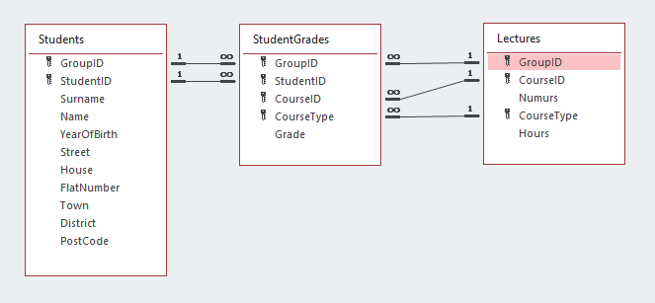
Practice
Create three related tables
Conditions:
Student 's year of birth >1900 and <2021
Grades >0 and <=10

Slide 21
Answers
CREATE TABLE Students (
GroupID varchar2(3) NOT NULL,
StudentID varchar2(2) NOT NULL,
Surname varchar2(20) NOT NULL,
Name varchar2(15),
YearOfBirth Number(4) NOT NULL Check (YearOfBirth>1900 and YearOfBirth<2021),
Street varchar2(50) NOT NULL,
House varchar2(8) NOT NULL,
FlatNumber varchar2(4) NULL,
Town varchar2(40) NOT NULL,
District varchar2 (75) NULL,
PostCode varchar2(7),
CONSTRAINT Students_pk
PRIMARY KEY (GroupID, StudentID)
);

Slide 22
Answers
CREATE TABLE Lectures (
GroupID varchar2(3) NOT NULL,
CourseID varchar2(2) NOT NULL,
CourseType varchar2(3) NOT NULL,
Hours number(3) NOT NULL,
CONSTRAINT Lectures_pk
PRIMARY KEY (GroupID, CourseID, CourseType)
);

Slide 23
Answers
CREATE TABLE StudentGrades (
GroupID varchar2(3) NOT NULL,
StudentID varchar2(2) NOT NULL,
CourseID varchar2(2) NOT NULL,
CourseType varchar2(3) NOT NULL,
Grade number(2) NOT NULL Check (Grade>0 and Grade<=10),
CONSTRAINT StudentGrades_pk
PRIMARY KEY (GroupID, StudentID, CourseID, CourseType),
CONSTRAINT StudentGrades_Students_fk
FOREIGN KEY (GroupID, StudentID)
REFERENCES Students (GroupID, StudentID),
CONSTRAINT StudentGrades_Lectures_fk
FOREIGN KEY (GroupID, CourseID, CourseType)
REFERENCES Lectures (GroupID, CourseID, CourseType)
);

Slide 24
Table deletion
Format:
DROP TABLE table_name;
Example:
Del_Library_script.sql

Slide 25
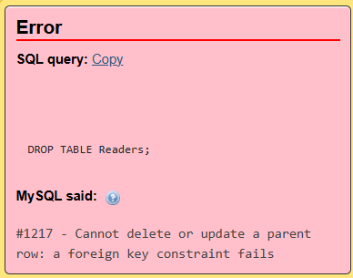
Table deletion
Example:
DROP TABLE Readers;

Slide 26
Practice
Move Journal table data that is older than 2011 to the JournalBackup table.
Define the primary key for the JournalBackup table.
Delete the NumOfCopies field from the JournalBackup table.
Add the NumOfCopies field to the JournalBackup table.
Change JournalBackup table NumOfCopies field type to text.
Delete the JournalBackup table.

Slide 27
Answers
1.1.
CREATE TABLE JournalBackup
AS
SELECT *
FROM Journal
WHERE YEAR(Datums) < 2011
;
1.2.
DELETE *
FROM Journal
WHERE YEAR(Datums) < 2011;
2.
ALTER TABLE JournalBackup
ADD PRIMARY KEY (RoomID, ServiceID, ReaderID, LibID, SDate, SStartTime);

Slide 28
Answers
3.
ALTER TABLE JournalBackup
DROP (NumOfCopies);
4.
ALTER TABLE JournalBackup
ADD NumOfCopies int(3);
5.
ALTER TABLE JournalBackup
MODIFY NumOfCopies varchar(3);
6.
DROP TABLE JournalBackup;

